Slide 1




Welcome to Nursing and Extended University!

Slide 2


Agenda
Welcome and Introductions
About CSUCI
Campus Accreditation
COVID Campus Requirements
Canvas New Student Orientation Course Dolphin Name and myCI
How to Register for Classes Financial Aid & Student Finance

Slide 3
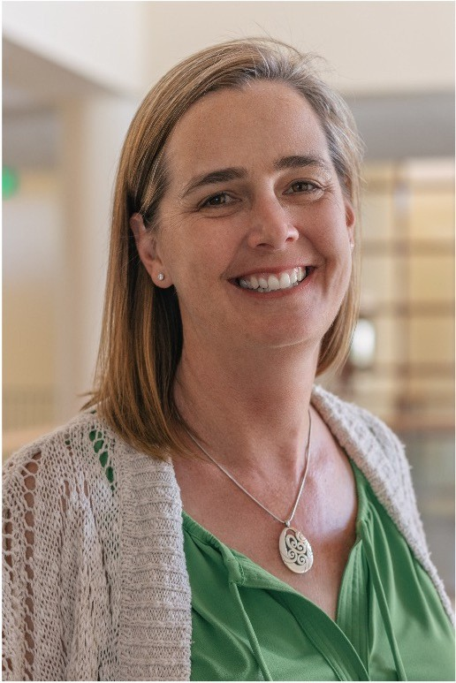
Welcome from
the Dean!
Dr. Jill Leafstedt
Dean of Extended University and Digital Learning

Slide 4
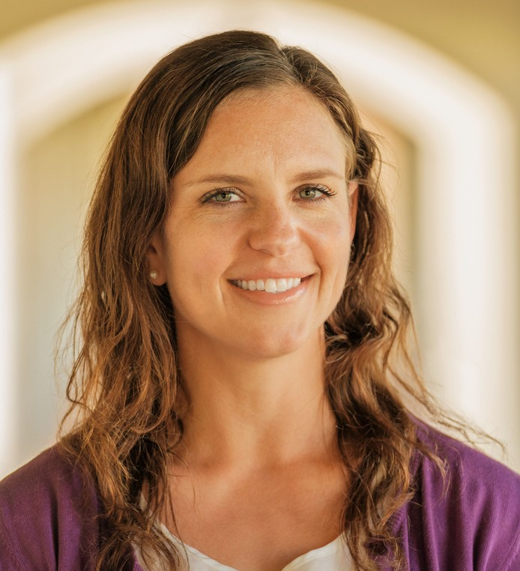
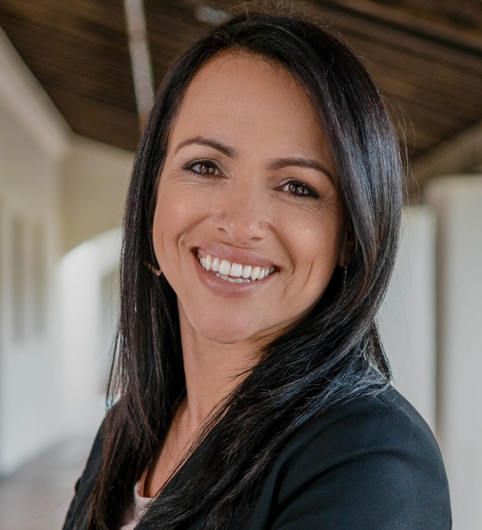
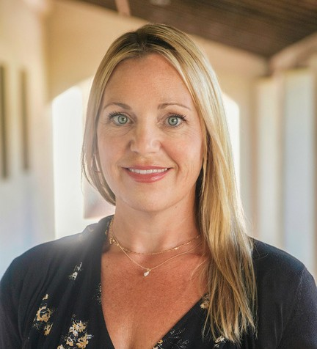
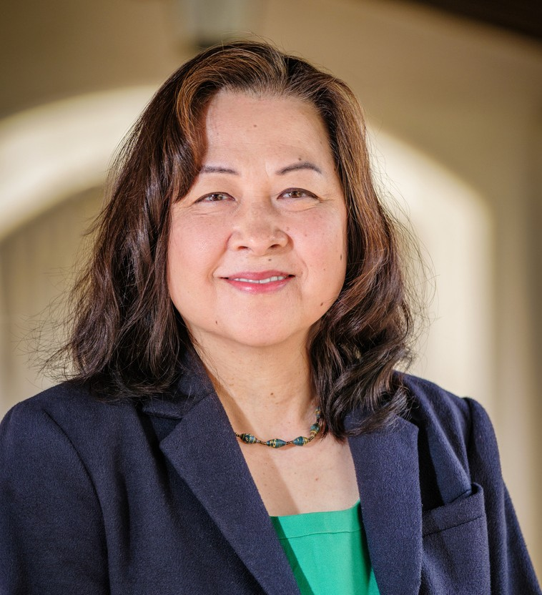
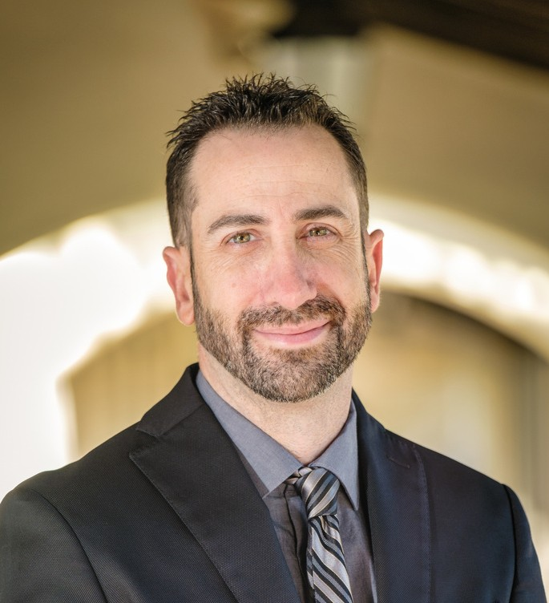
Welcome from the Leadership Team
...And all of our amazing staff!!
Lorna
Gonzalez,Ph.D.
Director Digital Learning
Jacky Connell
Jaime Hannans,
Ph.D.
Associate Dean
Director
Finance & Administration
Daniel Banyai
Director of Enrollment, Marketing, and Workforce Development
Mayumi Kowta
Director International Programs

Slide 5
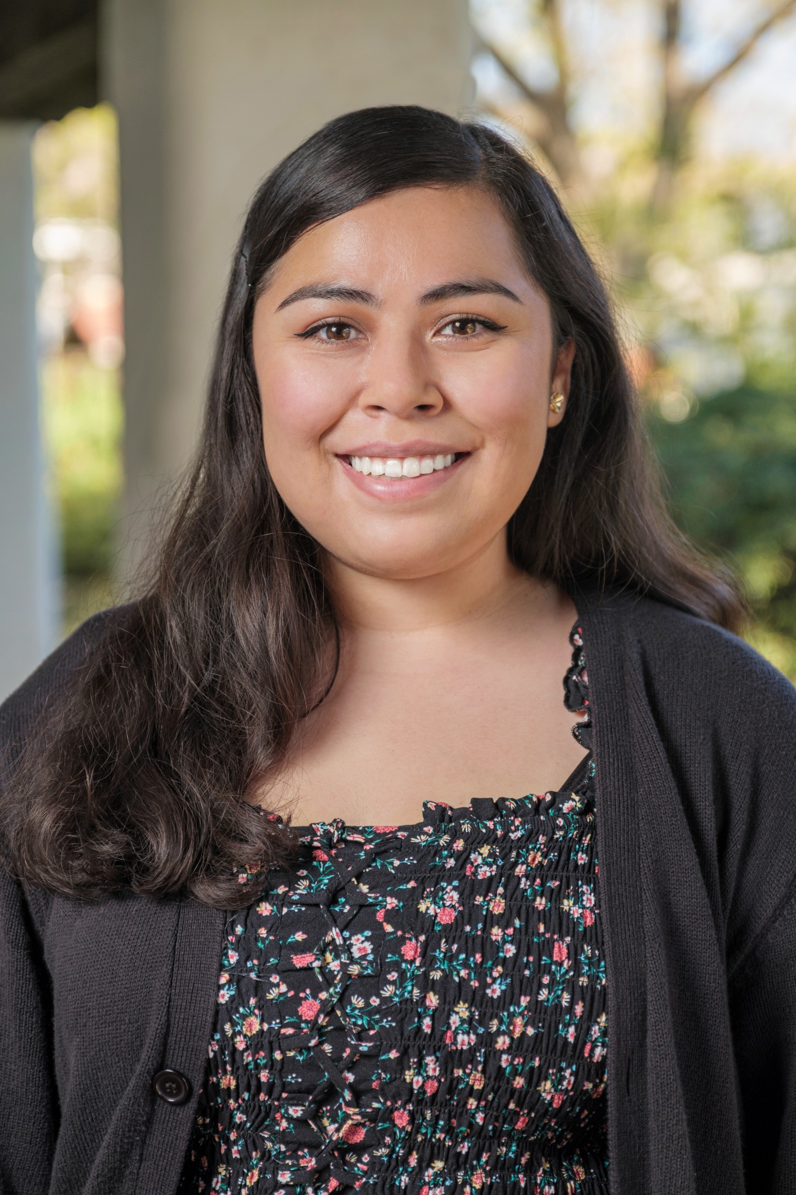

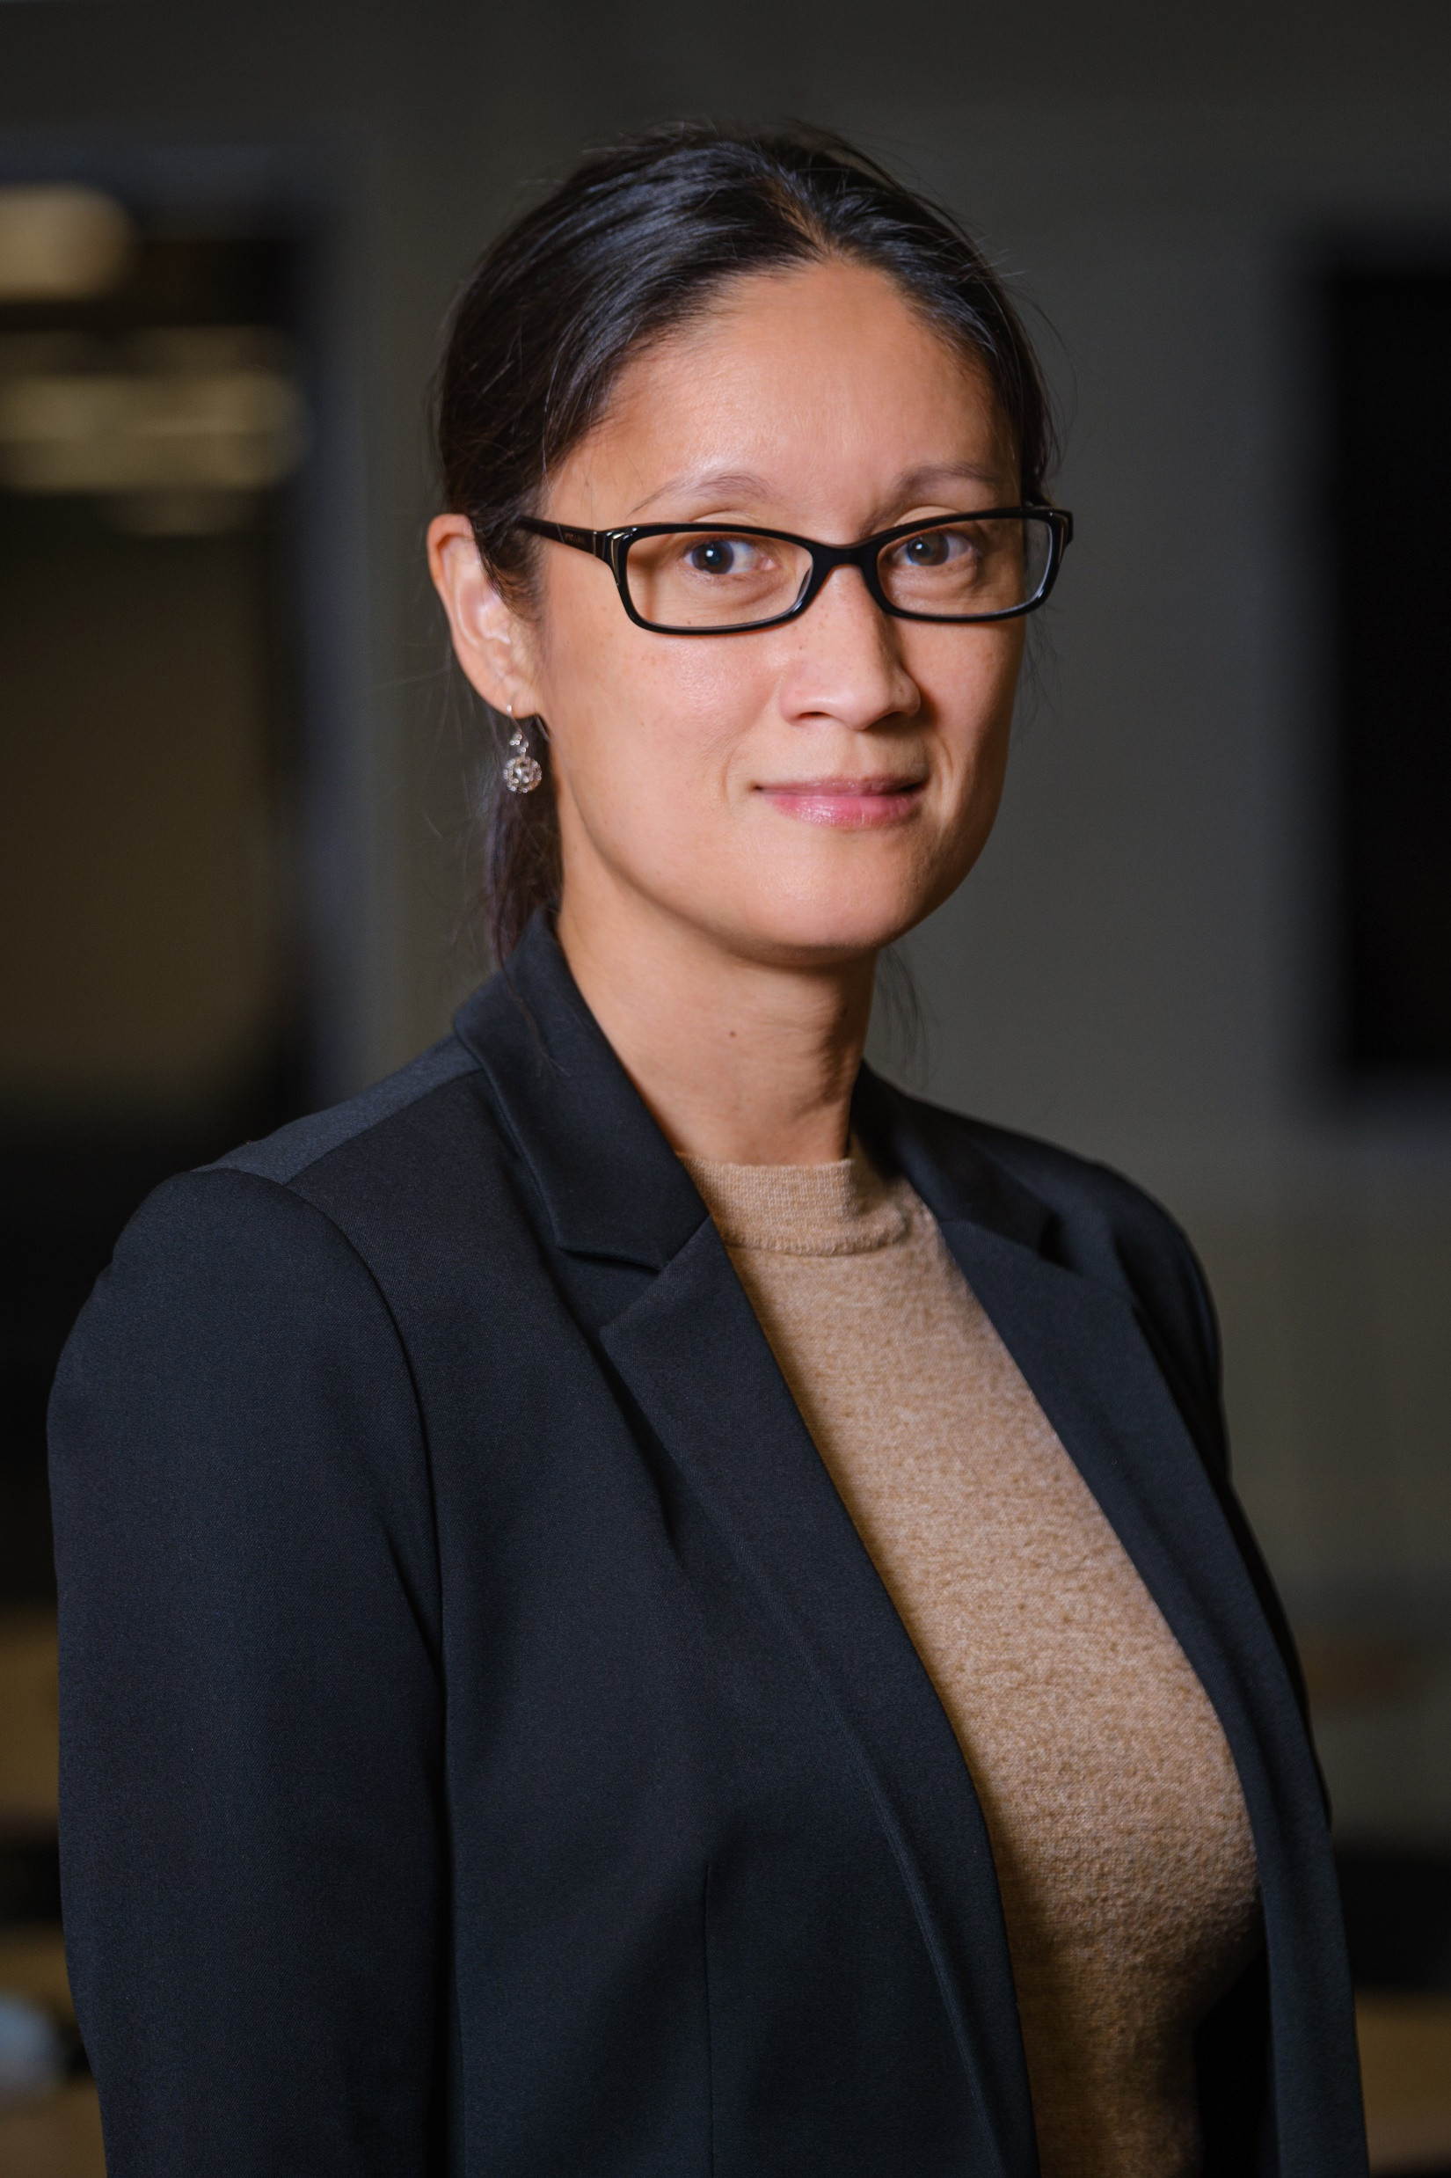
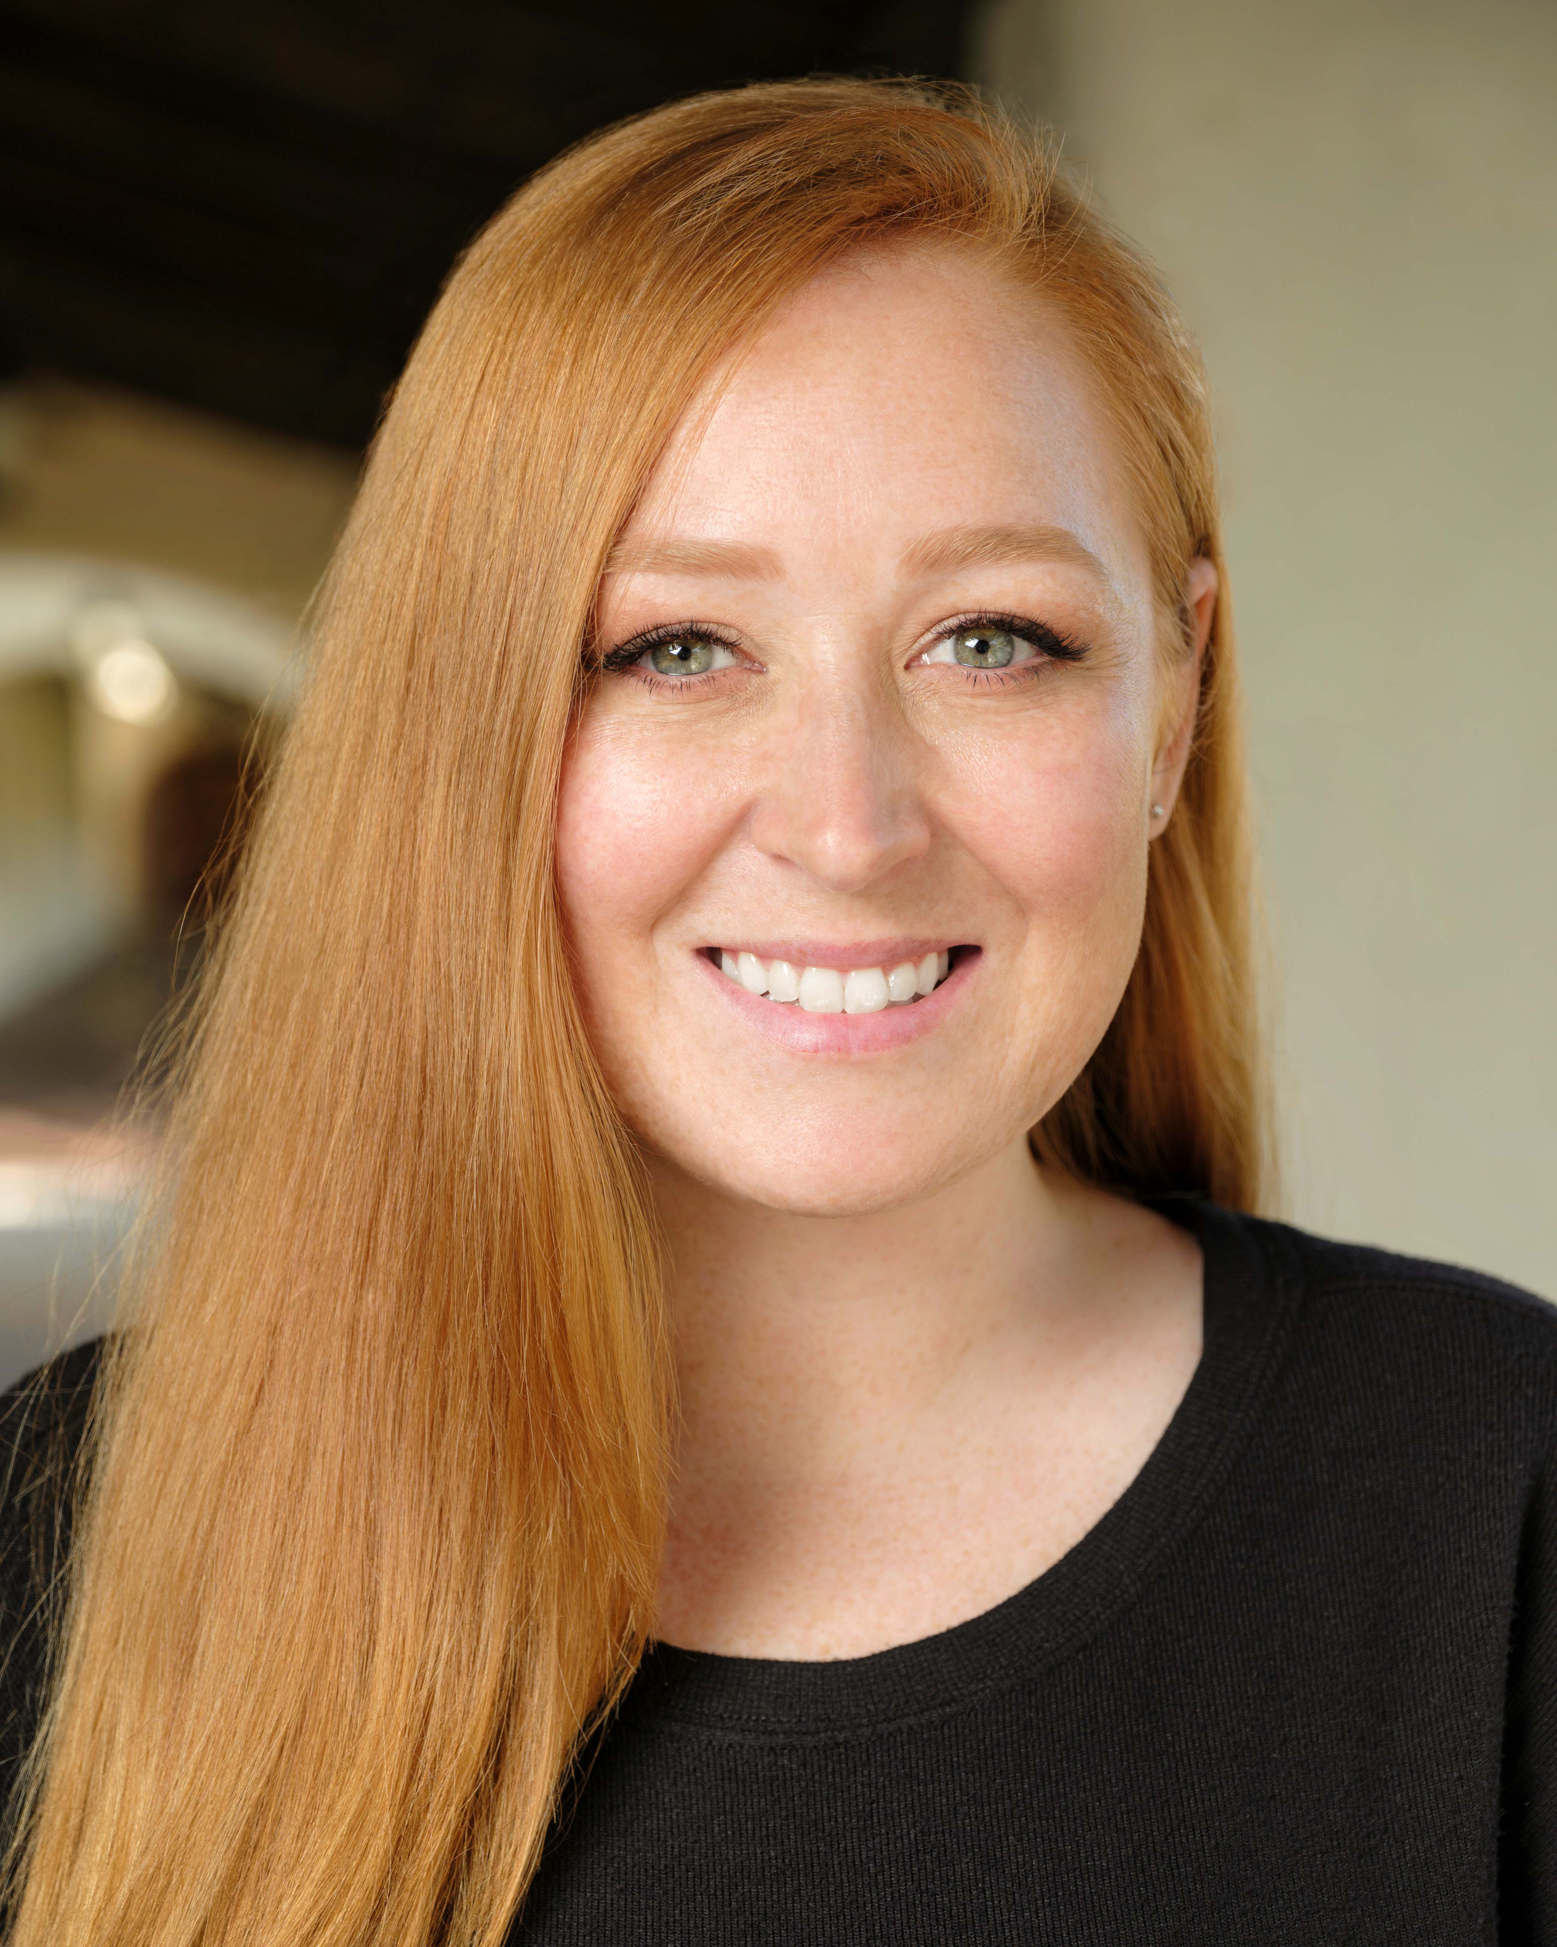
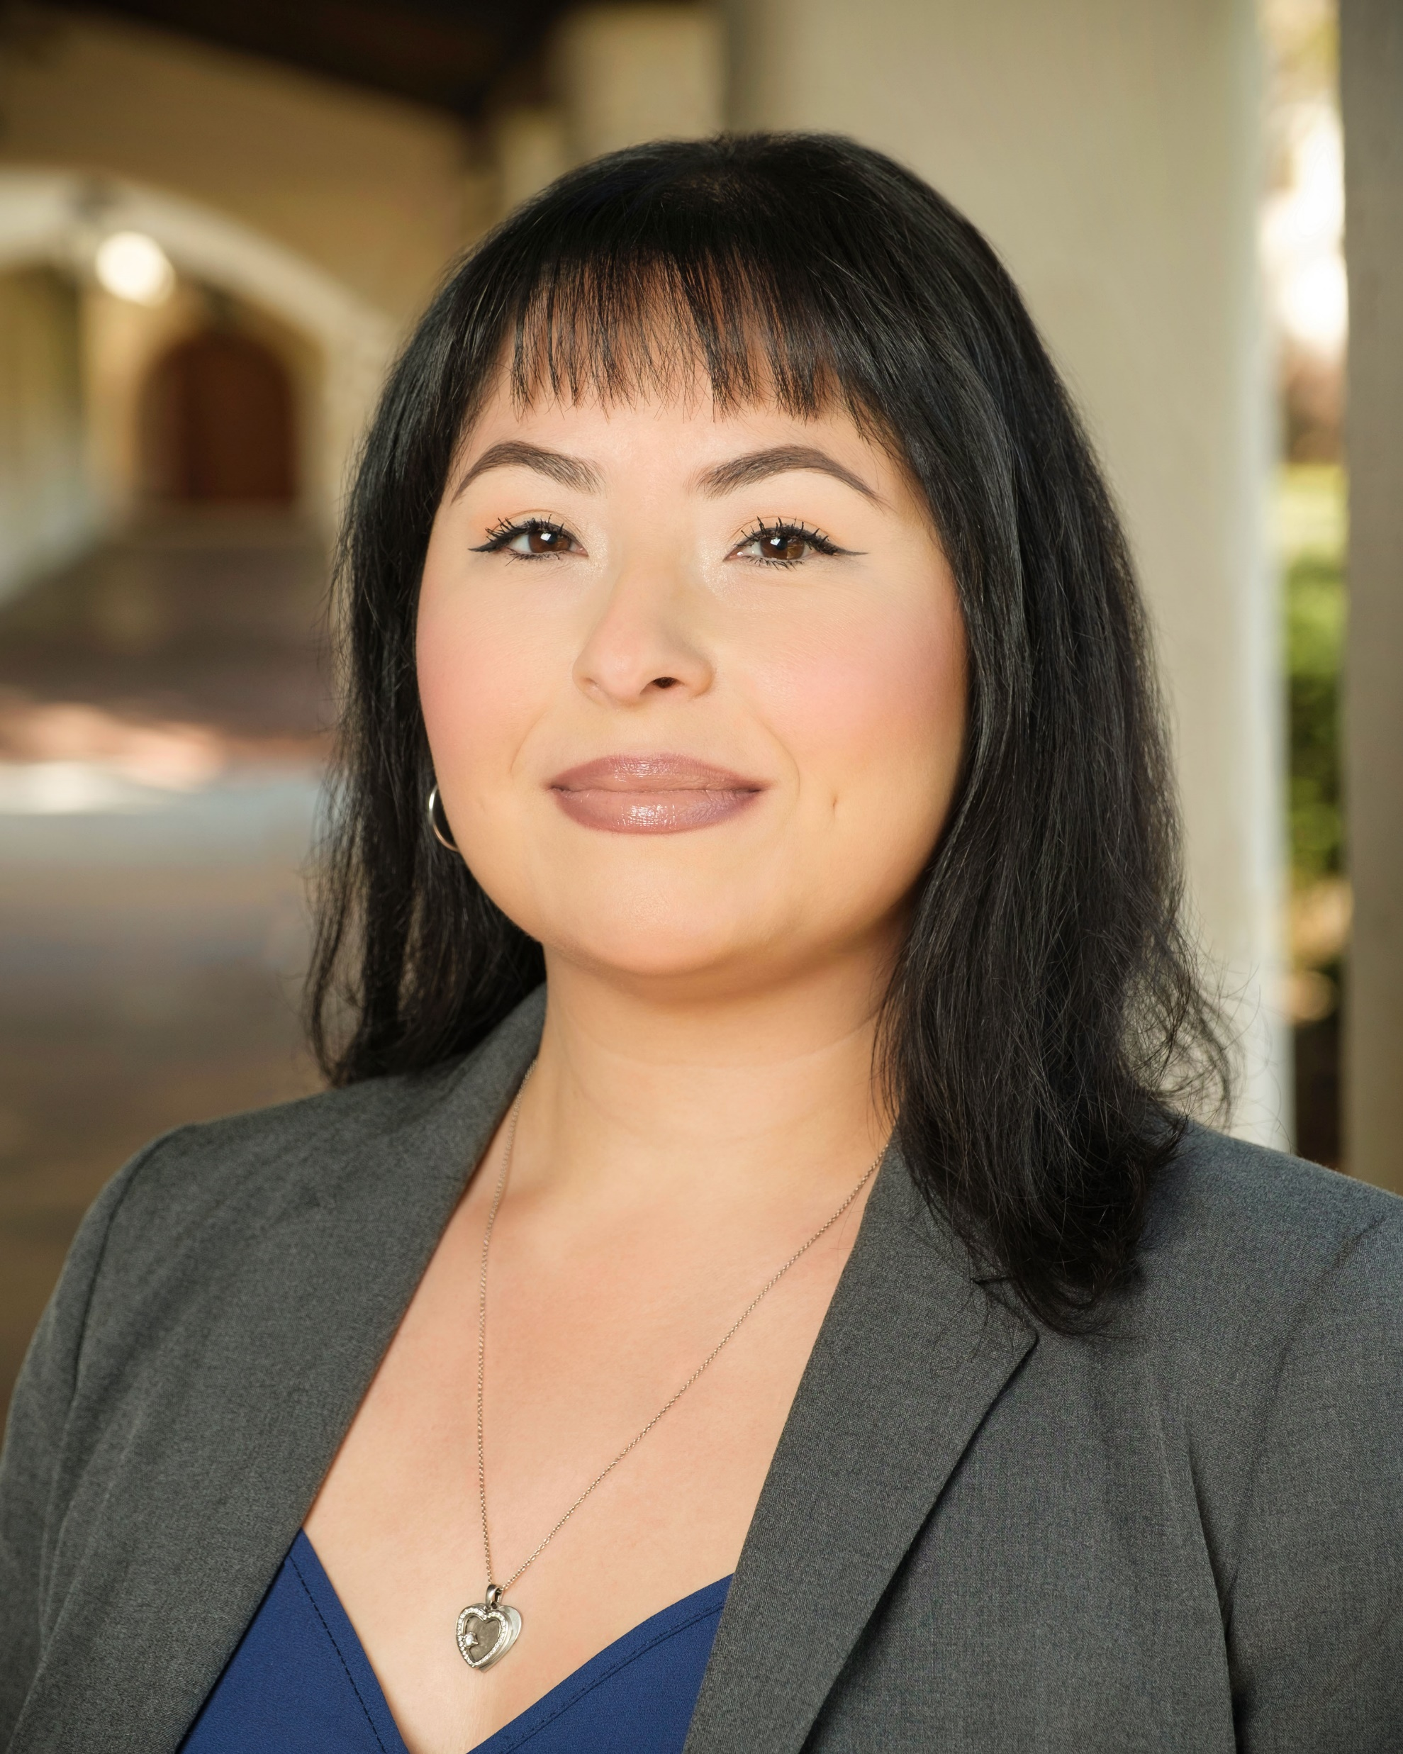
Your EU student support team!
Monica Carrillo
Student Experience and Success Counselor
Sebastian Lopez
Financial Aid Counselor
Jingle Mitchell
EU Nursing Support Coordinator
Emma Battles Guetter
Admission, Records, and Student Services Coordinator
Neomi Basquez
Student Finance Specialist

Slide 6

CSUCI Mission
Placing students at the center of the educational experience, California State University Channel Islands provides undergraduate and graduate education that facilitates learning within and across disciplines through integrative approaches, emphasizes experiential and service learning, and graduates students with multicultural and international perspectives.

Slide 7
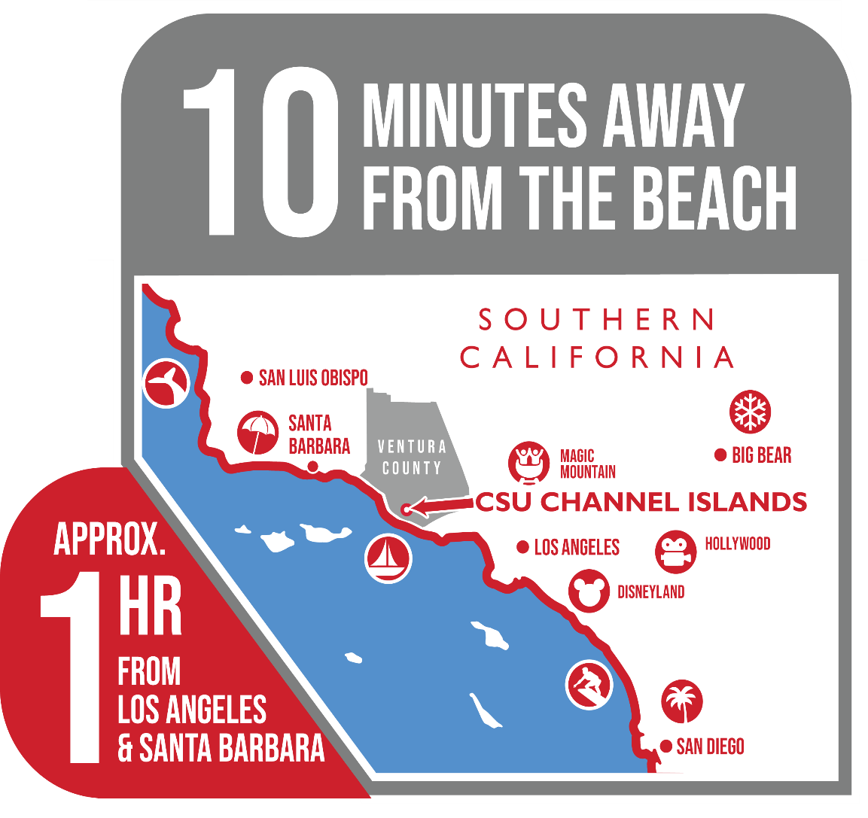







5,700 Students
22:1 Faculty Ratio
Hispanic Serving Institution (HIS)
76º
Average Temp.
go.csuci.edu/Get2Know
Notes:
HIS: met the diversity threshold of having at least 25% Hispanic population.

Slide 8

WASC Accreditation
California State University Channel Islands (CSUCI) receives accreditation from Western Association of Senior College and University Commission (WSCUC).
Because of the high quality of its last accreditation results, CSUCI was chosen as part of a select group of institutions to undergo Thematic Pathway for Reaffirmation (TPR). For more information regarding the 2024 accreditation process, please visit our TPR page.
The next site visit will be Spring 2024.

Slide 9


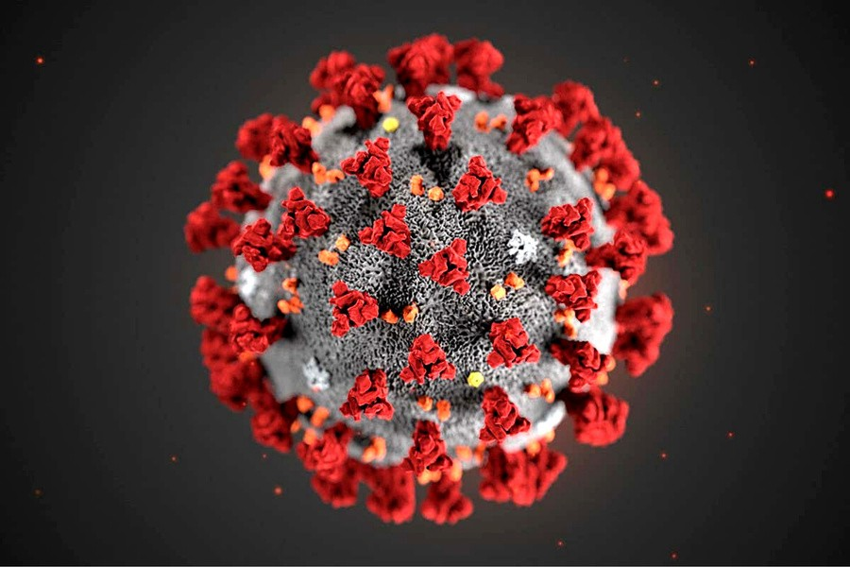
COVID Requirements
Per the CSU Vaccination Policy, the vaccine is recommended but not required.
Complio How To Guide
**Nursing may have additional guidelines or policies for the program or clinical facilities.
COVID Certification
The University has partnered with American DataBank to use Complio to collect and store student vaccine certification information.
If you have questions about this process, please contact healthycsuci@csuci.edu. Technical questions about Complio should be directed to complio@americandatabank.com.
Visit https://csuci.complio.com/

Slide 10


New Student Orientation Canvas Course

Slide 11

Highlights
Technology & Canvas Basics: myCI and Services
Registration & Records: How to Register for Classes
Financial Aid & Scholarships: Contact and Student Finance Information

Slide 12

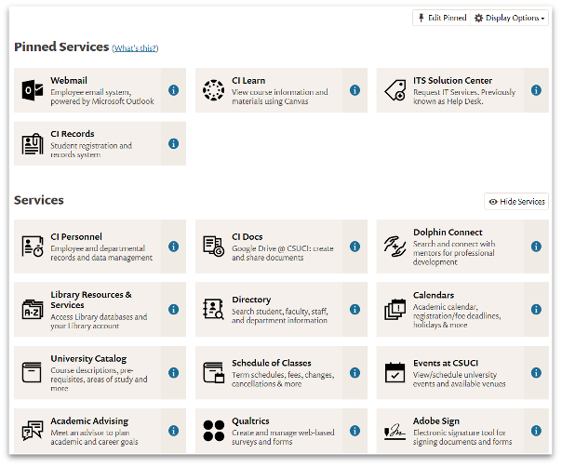
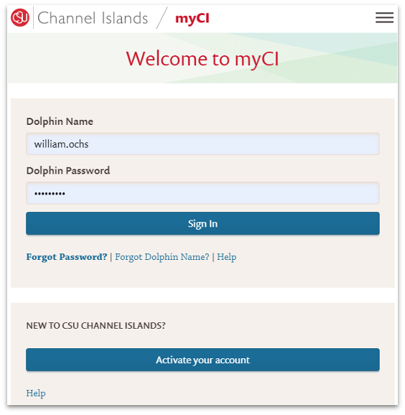
Dolphin Name myCI

Slide 13
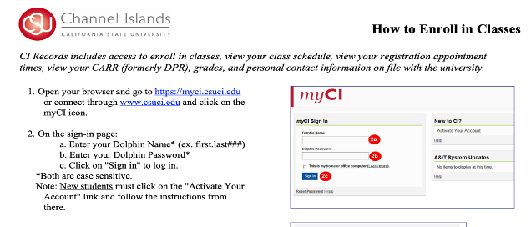
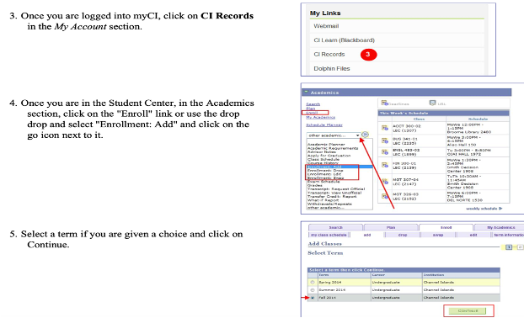
How to Register for Classes

Slide 14
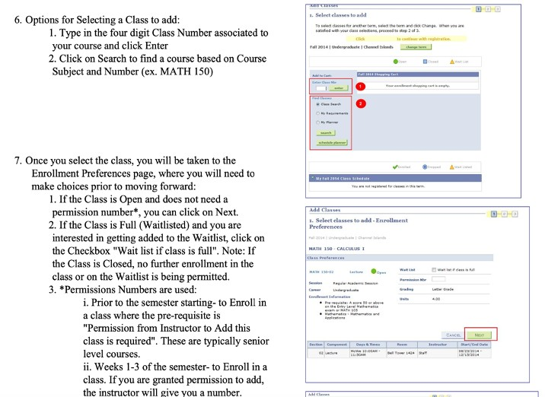
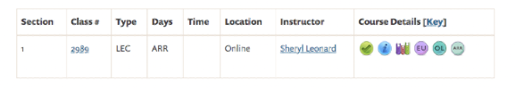
How to Register for Classes
Double check the class number and section
Make sure the course is listed as EU course

Slide 15
Financial Aid
Primary form of communication: myCI email
Contact us
Email: sebastian.lopez@csuci.edu Phone: 805-437-1617
Additional Resources
Website: www.csuci.edu/financialaid Financial Aid TV (Instructional videos)

Slide 16
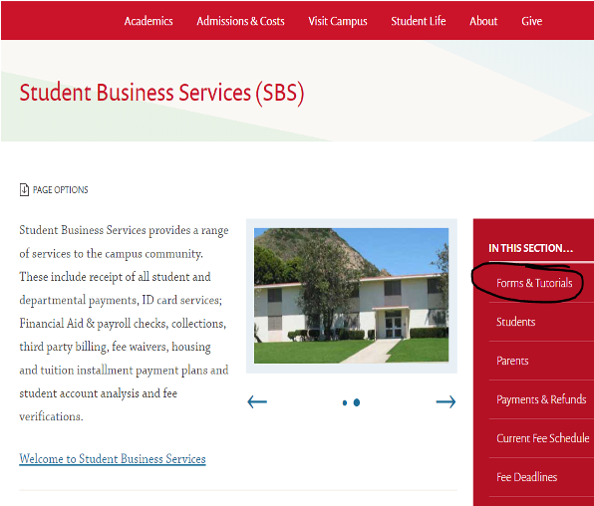
Student Finance
Fees and Making Payments
Program Cost is per unit
One Due Date Per Session
Payment Plan Available
Payment Options:
  In-person (cash, check, money order)
  Online (E-Check, Credit/Debit)
  Mail (check, money order)
Contact Information: Neomi Basquez
Student Finance Specialist neomi.basquez771@csuci.edu

Slide 17
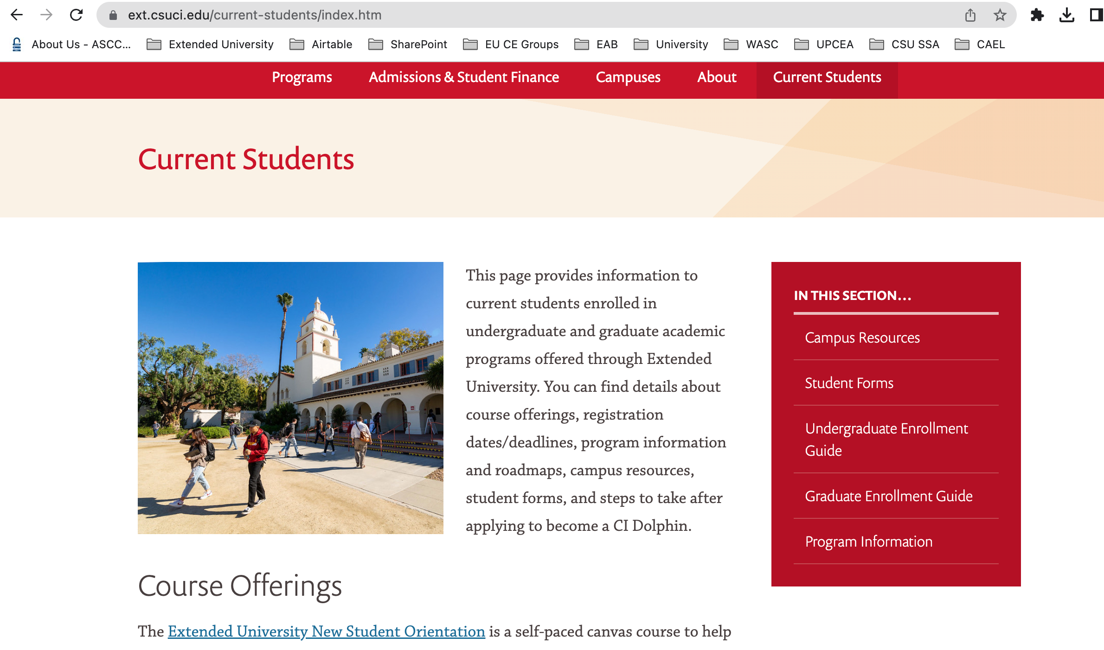
Extended University Resources

Slide 18

Student Support
Explore the Canvas New Student Orientation for help with:
Library Articles or Journals Writing Support
Tutoring and Study Skills
Counseling and Psychological Services Basic Needs, Food, Housing
and more!

Slide 19
Thank you! Questions?
ext.csuci.edu

