Slide 1
MSN Orientation May 24, 2023
Dr. Lynette Landry, Program Chair
Dr. LaSonya Davis, Assistant Chair
Dr. Aaron McColpin, Associate Professor
Dr. Vanessa Atyabi, MSN Program Director
Hope Lilienthal, Nursing Clinical Coordinator
Jingle Mitchell, Extended University Nursing Clinical Coordinator

Slide 2
Communication & Resources
Use your myCI email!!!
Forward it to your phone or main email account.
(Need help: Contact Information Technology Services (ITS) at 805-437-8552 or https://www.csuci.edu/its/)
Official form of communication from CI and program.
Check a minimum of twice a week
Materials, books, resources, medical app, and much more…
The Cove Bookstore CSUCI Bookstorehttp://www.csuci.bkstr.com/

Slide 3
MSN Family Nurse Practitioner, Full Time
First Year (27 units)
One-week on campus intensive course (prior to the start of fall semester) |  |  |  |  | Units
NRS 500 Advanced Health Assessment and Promotion |  |  |  |  | 3
One-week on campus intensive course (prior to the start of spring semester) |  |  |  |  | Units
NRS 525 Laboratory and Clinical Procedures for Advanced Practice |  |  |  |  | 1
Fall | Units | Spring | Units | Summer 1 (10 weeks) | Units
NRS 502 Advanced Pathophysiology NRS 504 Advanced Pharmacology | 3 3 | NRS 508 Evidence-based Practice and Quality Improvement NRS 520 Primary Care Across the Lifespan I NRS 521 Clinical Practicum: Primary Care Across the Lifespan I | 3 3 4 | NRS 506 Theoretical Frameworks and Professional Roles NRS 512 Informatics in Advanced Nursing Practice | 3 3
Total: | 6 | Total: | 9 | Total: | 6
Second Year (19 units)
Fall | Units | Spring | Units | Summer 1 (10 weeks) | Units
NRS 524 Primary Care Across the Lifespan II NRS 523 Clinical Practicum: Primary Care Across the Lifespan II | 3 4 | NRS 510 Healthcare Policy and Nursing Issues NRS 526 Primary Care Across the Lifespan III NRS 527 Clinical Practicum: Primary Care Across the Lifespan III | 3 3 4 | NRS 540 Culminating Experience | 3
Total: | 7 | Total: | 10 | Total: | 3
On campus intensive 7/31-8/5
On campus 1/22 – 1/26/ 24
Total 540 practicum hours
Do Not Enroll in NRS 540 until you’ve completed your practicum hours

Slide 4
MSN Family Nurse Practitioner, Part Time
First Year (18 units)
One-week on campus intensive course (prior to the start of fall semester) |  |  |  |  | Units
NRS 500 Advanced Health Assessment and Promotion |  |  |  |  | 3
Fall | Units | Spring | Units | Summer 1 (10 weeks) | Units
NRS 502 Advanced Pathophysiology | 3 | NRS 508 Evidence-based Practice and Quality Improvement NRS 510 Healthcare Policy and Nursing Issues | 3 3 | NRS 506 Theoretical Frameworks and Professional Roles | 3
Total: | 6 | Total: | 6 | Total: | 3
Second Year (13 units)
One-week on campus intensive course (prior to the start of spring semester) |  |  |  |  | Units
NRS 525 Laboratory and Clinical Procedures for Advanced Practice |  |  |  |  | 1
Fall | Units | Spring | Units | Summer 1 (10 weeks) | Units
NRS 504 Advanced Pharmacology | 3 | NRS 520 Primary Care Across the Lifespan I NRS 521 Primary Care Across the Lifespan I Practicum | 3 4 | NRS 512 Informatics in Advanced Nursing Practice | 3
Total: | 3 | Total: | 7 | Total: | 3
Third Year (17 units)
Fall |  | Spring
NRS 524 Primary Care Across the Lifespan II NRS 523 Primary Care Across the Lifespan II Practicum | 3 4 | NRS 526 Primary Care Across the Lifespan III NRS 527 Primary Care Across the Lifespan III Practicum | 3 4 | NRS 540 Culminating Experience | 3
Total: | 7 | Total: | 7 | Total: | 3
On campus intensive 7/31-8/5
At beginning of spring 2025 semester
Total 540 practicum hours
Do Not Enroll in NRS 540 until you’ve completed your practicum hours

Slide 5
Post-Master’s FNP Certificate Program
On campus intensive 7/31-8/5
First Year (8-17 units)
One-week on campus intensive course (prior to the start of fall semester) |  |  |  | Units
NRS 500 Advanced Health Assessment and Promotion |  |  |  | 3*
One-week on campus intensive course (prior to the start of spring semester) |  |  |  | Units
NRS 525 Laboratory and Clinical Procedures for Advanced Practice |  |  |  | 1
Fall | Units | Spring |  | Units
NRS 502 Advanced Pathophysiology NRS 504 Advanced Pharmacology | 3* 3* | NRS 520 Primary Care Across the Lifespan I NRS 521 Primary Care Across the Lifespan I Practicum |  | 3 4
Total: | 6 | Total: |  | 7
Second Year (13 units)
Fall | Units |  | Spring | Units
NRS 524 Primary Care Across the Lifespan II NRS 523 Primary Care Across the Lifespan II Practicum | 3 4 |  | NRS 526 Primary Care Health Across the Lifespan III NRS 527 Primary Care Across the Lifespan III Practicum | 3 4
Total: | 7 |  | Total: | 7
On campus intensive 1/22 – 1/26/24
Total 540 practicum hours
* If NRS 500, NRS 502, and NRS 504 were not previously completed, these courses must be taken at CSU Channel Islands to receive the FNP Certificate. If NRS 500, NRS 502, and/or NRS 504 are taken at CSU Channel Islands then an additional 3-9 units will need to be completed.

Slide 6
Nurse Educator Full-Time
First Year (24 units)
One-week on campus intensive course (prior to the start of fall semester) |  |  |  |  | Units
NRS 500 Advanced Health Assessment and Promotion |  |  |  |  | 3
Fall | Units | Spring | Units | Summer 1 (10 weeks) | Units
NRS 502 Advanced Pathophysiology NRS 504 Advanced Pharmacology | 3 3 | NRS 508 Evidence-based Practice and Quality Improvement NRS 510 Healthcare Policy and Nursing Issues NRS 537 Nurse Educator Practicum I | 3 3 3 | NRS 506 Theoretical Frameworks and Professional Roles NRS 512 Informatics in Advanced Nursing Practice | 3 3
Total: | 9 | Total: | 9 | Total: | 6
Second Year (15 units)
Fall | Units | Spring | Units
NRS 532 Concepts of Adult Learning NRS 534 Curriculum Development and Evaluation for Nurse Educators | 3 3 | NRS 536 Innovations in Teaching and Learning NRS 539 Nurse Educator Practicum II NRS 540 Culminating Experience | 3 3 3
Total: | 6 | Total: | 6
On campus intensive 7/31-8/5
Total 270 practicum hours

Slide 7
Nurse Educator Part-Time
First Year (18 units)
Theory course with on campus intensive |  |  |  |  | Units
NRS 500 Advanced Health Assessment and Promotion |  |  |  |  | 3
Fall | Units | Spring | Units | Summer 1 (10 weeks) | Units
NRS 502 Advanced Pathophysiology NRS 504 Advanced Pharmacology | 3 3 | NRS 508 Evidence-based Practice and Quality Improvement NRS 510 Healthcare Policy and Nursing Issues | 3 3 | NRS 512 Informatics in Advanced Nursing Practice | 3
Total: | 9 | Total: | 6 | Total: | 3
Second Year (12 units)
Fall | Units | Spring | Units | Summer | Units
NRS 532 Concepts of Adult Learning | 3 | NRS 536 Innovations in Teaching and Learning NRS 537 Nurse Educator Practicum II | 3 3 | NRS 506 Theoretical Frameworks and Professional Roles | 3
Total: | 3 | Total: | 6 |  | 3
Third Year (9 units)
Fall | Units | Spring | Units
NRS 534 Curriculum Development and Evaluation for Nurse Educators | 3 | NRS 539 Nurse Educator Practicum II NRS 540 Culminating Experience | 3 3
Total: | 3 | Total: | 6
On campus intensive 7/31-8/5
Total 270 practicum hours

Slide 8
Academic Advising
Family Nurse Practitioner Students
All NP students must schedule a time to meet this summer with Dr. Atyabi to develop your initial academic.
Meet with the Dr. Atyabi each semester to revise your plan, as necessary.
Nurse Educator Students
Meet with your assigned advisor during your 1st semester to plan your 1st practicum course.

Slide 9
Extended University Nuts & Bolts

Slide 10
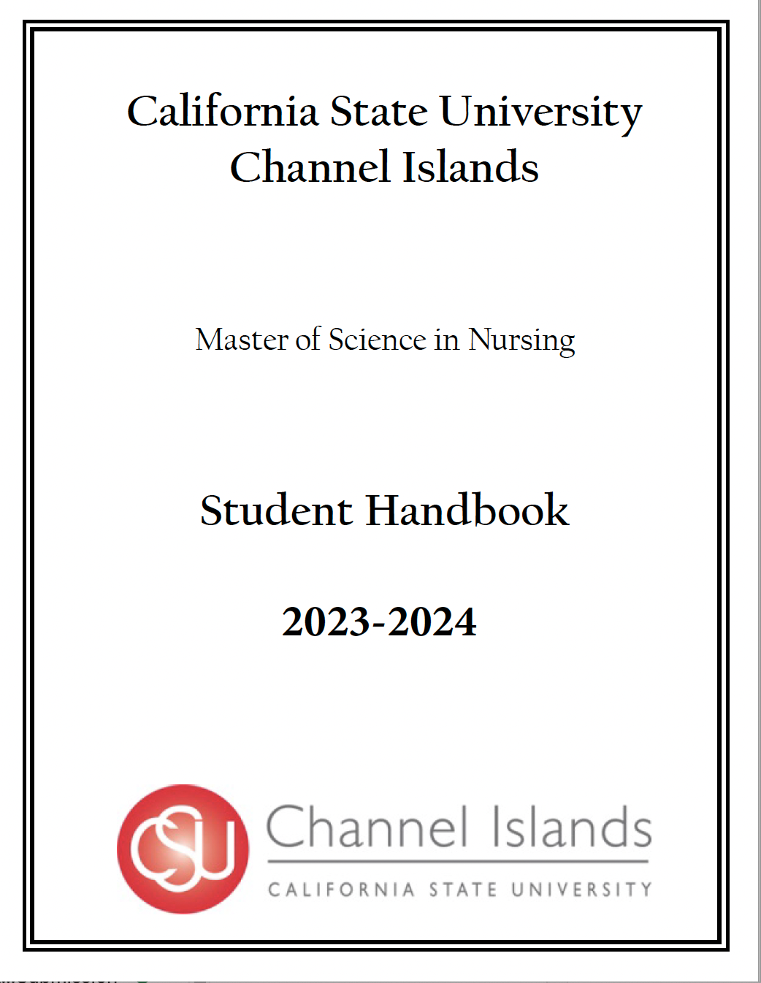
Student Handbook

Slide 11
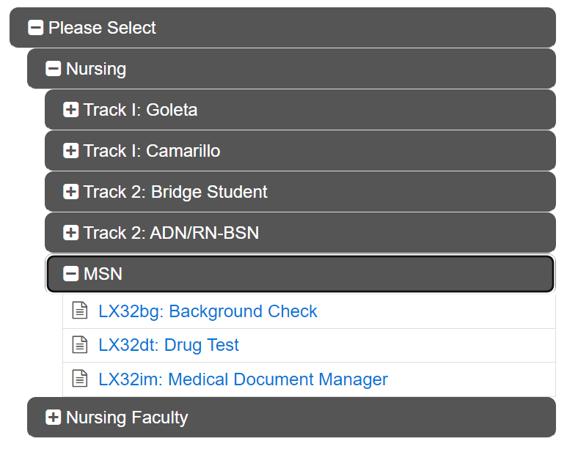
CastleBranch: Medical Document Manager, Background Check & Drug Test
https://portal.castlebranch.com/LN20/package-selection
-Package cost is $123
MUST be purchased 3 months
before start of clinicals
***Please use CI Email when setting up CastleBranch account

Slide 12
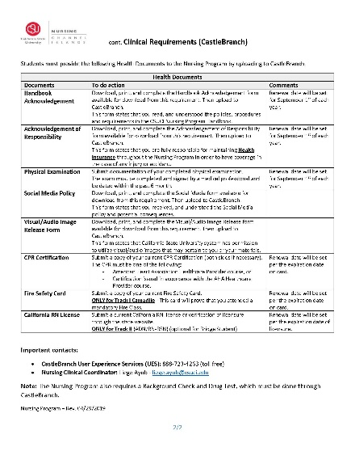
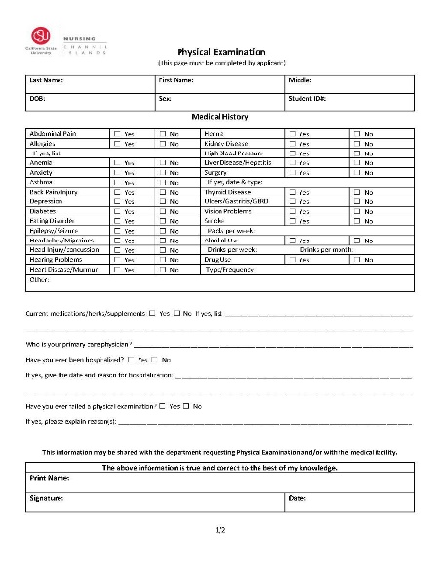
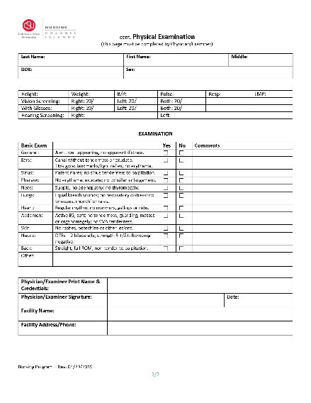
Physical Examination & Immunization Requirements
Page 1: You complete your information and sign.
Page 2: Medical Provider completes and signs.
Immunizations:
TB QuantiFERON Gold Blood Test (ANNUAL)
Hep B, MMR, Tdap, Varicella, & Flu (ANNUAL)
COVID-19 Vaccines
Student Health Services located in Yuba Hall can assist, call 805-437-8828 to schedule an appointment. (Summer Hours: M-Th, 9am-2pm)

Slide 13
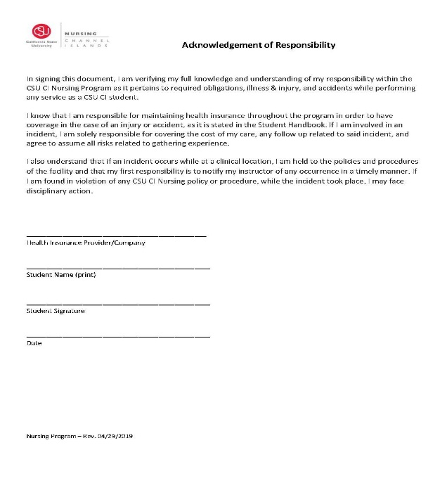
Health Insurance & CPR Certification
Health Insurance
BLS
Course must be for Healthcare Providers
MUST be through American Heart Association
Upload to CastleBranch
By: Due Date listed on Checklist

Slide 14
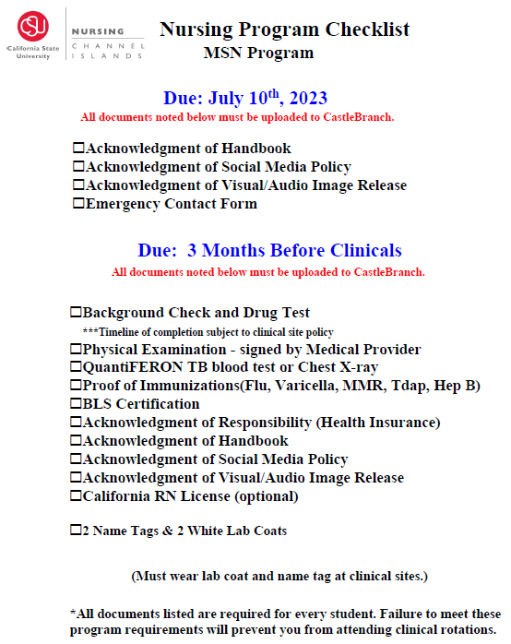
Nursing Program Checklist

Slide 15
Lab Coats & Name Tags
Items must be ordered prior to the start of your clinical work
On Duty Uniforms
4572 Telephone Road #920
Ventura, CA 93003
805-650-3889
Hours: Mon-Fri 9am to 5pm & Sat 9am to 3pm
White Lab Coats (2)
Two name tags
Will be used in Clinicals AND Lab

Slide 16
Culminating Experience
Review the Culminating Experience Handbook before you start your MSN core courses in January
First part of the culminating experience the same no matter what format:
Background/problem statement
Literature review
Four format options:
Analysis paper
Evidence-based Practice
Clinical Protocol/Standardized Procedure
Education Plan
You will start work on your culminating experience in your evidenced-based practice course
Connect with faculty who have a shared interest
Take the culminating experience course after you’ve completed 90% of your practica hours

Slide 17
Portfolios
Family Nurse Practitioner Students
Use the portfolio section of Typhon
Build personal profile
Include resume/CV, short bio
Your nursing philosophy
Extra-curricular activities that highlight your professional development
Key course assignments from each course
Upload completed assignment
Add reflective statement that focuses on what you learned in the course and how completion of the assignment demonstrated you met the expected course outcomes
Nurse Educator Students
Use Google sites
Develop pages for each course that includes a course description and lists the course learning outcomes
Upload your course assignment to the page
Add your reflective statement
Share your Google site with faculty

Slide 18
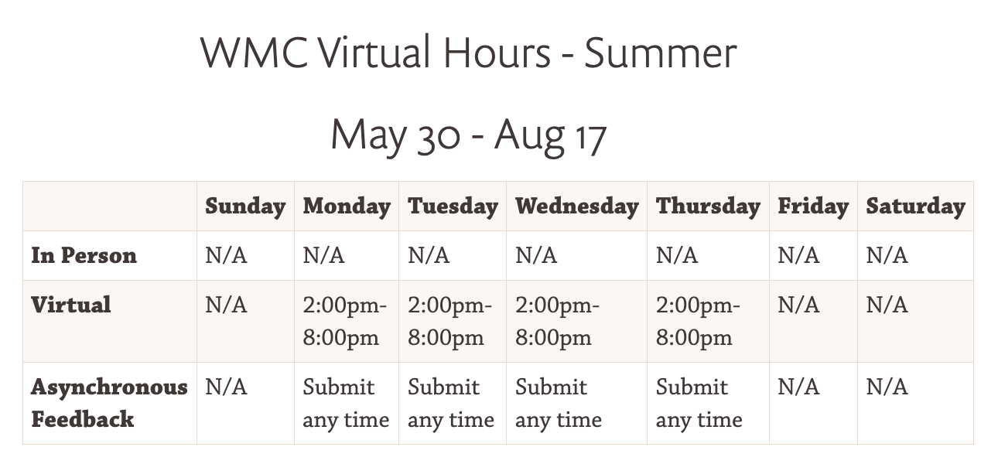
CI Writing & Multiliteracy Center
Support Offered
Written, Oral, Visual, & Digital forms of communication (papers/presentations)
APA formatting assistance
Citation resources https://www.csuci.edu/wmc/student-citation.htm
Style Guide
APA’s “Basics of APA Style” slideshow
APA Quick Reference Guide
Purdue Owl https://owl.purdue.edu/owl/research_and_citation/apa_style/apa_formatting_and_style_guide/index.html

Slide 20
Primary Care Across Lifespan I, II, III (NRS 521, NRS 523, NRS 527)
4-unit course offered Fall and Spring ONLY (16 weeks)
Clinical hours with preceptor, online patient SOAP notes through Typhon
4 units enrolled=180 clinical hours (45 hours per unit)
Approx 1-2 days per week (12 hours) of clinical expected

Slide 21
NP Placements-Clinical Hours Requirement
Total Program Clinical Requirements: 540 Clinical Hours of Direct Patient Care
400 Hours of Primary Care (Must include older adults)
92 Hours seeing Pediatric Patients (infant-21 years old)
48 Hours seeing Women's Health Patients (8 hours must be OB related)
*No more than 100 hours in specialty practice
*Urgent care counts towards any of these categories
*You can stay in primary care to complete all of these hours if you see these type of patients

Slide 22
Type of Placements
Family Medicine/Primary Care (Preferred)
Urgent Care
Pediatrician
Community Clinics
Hospitals, EDs
Specialty Clinics (no more than 100 hours!)
This Photo by Unknown Author is licensed under CC BY

Slide 23
Your Placement Team
You
Dr. Vanessa Atyabi (FNP Director)
Jingle Mitchell (Nursing Support Coordinator)

Slide 24
Placement Steps-Plan Ahead and Early
Determine Placement Start Date (Spring Year I FT, Spring Year 2 PT)
Use your network! Ask a preferred provider. Send start date, projected hours, CV. Or ask for our suggestions.
Email Nursing Support Coordinator regarding contract (AA) status, and wait for contract to be completed.
If contract complete, start onboarding
Complete onboarding requirements. Update castle branch if needed.
Set schedule directly with preceptor
Start Clinical !
Ask Preceptor if they can precept again!

Slide 25
Practicum Expectations
Before starting practicum work
Connect with Nursing Support Coordinator
Current Affiliation Agreement in place
Assure you’re up-to-date with all health requirements, background checks and drug screens
If going to Cottage, then DO NOT have background check or drug screen completed more than 30 days before your start date
Identify and meet with preceptor
Set schedule for practicum hours
If you commit to doing a shift and can’t make it let the agency know.
Communicate hour information with your faculty
Log-in to Typhon
Check to make sure your preceptor is listed in Typhon
Notify MSN Director or FNP Program Coordinator if not your preceptor is not in Typhon
Enter time logs for each clinical day, minimally weekly
Enter case logs regularly
Meet with your preceptor and your faculty minimally three times during the semester to review clinical expectations and assess progress

Slide 26
Remember to BALANCE Work, Clinical, and Home Life and get REST! Take Breaks!

Slide 27
Typhon
The Nursing Program utilizes the Typhon Group’s Nursing School Student Tracking System (NSST) for documentation of FNP students for documentation of clinical time, procedures, and ePortfolio.
The system is an internet-based integrated evaluation tool used to maintain a log of a student’s hours and progress toward meeting the MSN
Essentials through clinical experiences.
This valuable tool will be used throughout the FNP program of study.
Typhon
http://typhongroup.net/csuci

Slide 28
Typhon Use
The expectation is that FNP students will enter TIME LOGS, and CASE LOGS into the Typhon database to document patient experiences, including how these experiences are linked to the FNP Essentials.
The Typhon site is HIPAA compliant and the data is protected.
Students use Typhon to track TIME LOGS (shift time) and within that tracking can make notes to provide further information about the type of experience completed.
Students are expected to indicate how these hours are linked to the FNP Essentials.
For each TIME LOG (shift time), students are expected to categorize the hours based on the FNP Essentials.

Slide 29
Typhon E-Portfolio
During each semester, students will complete a portfolio to document meeting the FNP Essentials.
The portfolio function of Typhon is available to students through out your course sequence.
Students are required to add documents to this section as they progress in the program.

Slide 30
APEA MyQBank
MyQBank is a suite of seven question banks.
CSUCI uses:
MyQBank Pathophysiology,
MyQBank Assessment,
MyQBank Prescribing,
Together, these banks provide 5,600 practice questions with detailed rationales.
GRANT GUILLORY
IT & University Support Specialist
800.899.4502 I www.apea.com
grant@apea.com

Slide 31
APEA Exams
The APEA 3P Exam evaluates student knowledge of pharmacotherapeutics, pathophysiology, and physical assessment, which are indicators of clinical readiness. This is a 90-minute exam with 75 questions.
The APEA University Predictor Exam is administered at the end of the last semester as preparation for the FNP, AGPCNP, PNP, and WHNP certification exams.
The results predict likelihood of success on the national exams for these specialties. APEA's University Predictor Exam is considered a national standardized comprehensive exit exam and can be used as a tool for student and curriculum evaluation. This is a 3-hour exam with 150 questions.

Slide 32
Contact Information
Lynette Landry lynette.landry@csuci.edu
LaSonya Davis lasonya.davis@csuci.edu
Aaron McColpin aaron.mccolpin@csuci.edu
Vanessa Atyabi vanessa.atyabi@csuci.edu
Jingle Mitchell jingle.mitchell@csuci.edu
Hope Lilienthal hope.lilienthal@csuci.edu

