Slide 1
Welcome
CSU Channel Islands Nursing
New Student Orientation I BSN
Dr. LaSonya Davis, Chair of Nursing
Dr. Aaron McColpin, Assistant Chair of Nursing
Hope Lilienthal, Clinical Coordinator
Stephanie Chavez, Nursing Evaluation Coordinator
Saijal Kapadia, Simulation Lab Tech Support
Gabriel Bautista, Nursing Analyst
Fall 2024
Notes:
LaSonya

Slide 2
Housekeeping/Paperwork
Website:
nursing.csuci.edu/incoming-students
Change of Major & Class Registration
Use your MyCI email!!!
Forward it to your phone or main email account.
Need help: Contact Information Technology Services at 805-437-8552 or http://www.csuci.edu/its
Check a minimum of twice a week, Official form of communication from CI and program.
Notes:
LaSonya

Slide 3
Student Handbook Review
Utilize the Student Handbook and other resources at: http://nursing.csuci.edu/currentstudents/index.htm
Notes:
LaSonya

Slide 4
REALLY Important Policies
Clinical Absence Policy
Clinical Coaching Policy
Student Promotion, Continuance in the Program, and Repeating a Class Policy
HIPAA Privacy Rule
Policy on Submission of Clinical and Medical Documents
Policy on Faculty Supervision of Medication Administration
Policy on IV Insertion
Policy on Social Media
Policy on Medication Calculation Competency Assessment
Notes:
LaSonya

Slide 5
Academic Advising
For General Education questions and requirements contact:
Academic Advising
http://www.csuci.edu/academics/advising/
For Nursing major advising you will visit:
Your designated Major Advisor (listed on website)
Verify Information continually on your CARR:
https://www.csuci.edu/records-registration/carr.htm
Notes:
LaSonya

Slide 6
Your “Roadmap” for the Nursing Program
Notes:
LaSonya

Slide 7
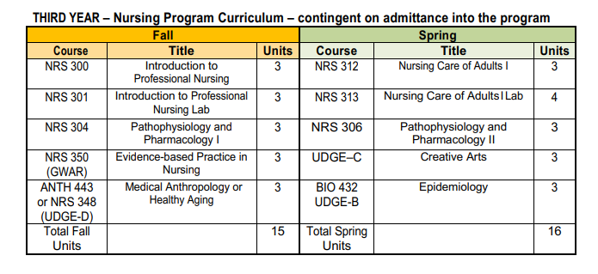
Curriculum Roadmap: 120 units
Notes:
LaSonya

Slide 8
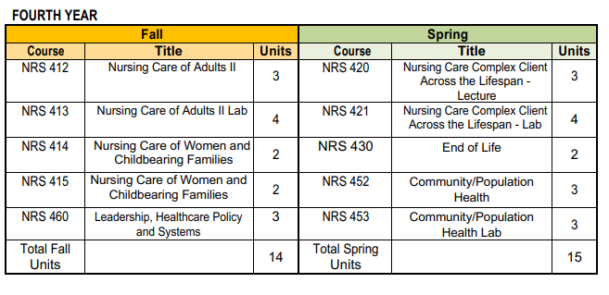
Notes:
LaSonya

Slide 9
BSN Orientation Course
All modules must be completed by July 15, 2024
Five modules:
Nursing Department Philosophy and Theoretical Framework
Implicit Bias
APA Writing and Plagiarism
Professionalism and Civility
Self-care and Resilience
Self-enroll in the course
https://cilearn.csuci.edu/enroll/HRBA6P

Slide 10
Program/Resource Purchase Requirements
Notes:
Steph

Slide 11
Lippincott Book Bundle & Course Products
You will get:
All program e-textbooks
PrepU Adaptive Quizzing
Lippincott Advisor for Education
VSim
NCLEX PreView, Review, and Ready for NCLEX testing
And more…
Cost: $2,598.78
Two payment options:
Pay in full by August 1st
or
Semester 1 – make a payment of $1868.83 (8/1) then
Semester 2-pay the balance of $728.95 (1/15).
Notes:
Steph

Slide 12
Uniforms, Name Tags & Stethoscope
Uniforms must be ordered by August 1, 2024
On Duty Uniforms
4572 Telephone Road #920
Ventura, CA 93003
805-650-3889
Hours: Mon-Fri 9am to 5pm & Sat 9am to 3pm
2 sets of scrubs & 2 name tags
Will be used in Clinicals AND Simulation Lab
Stethoscopes: Must purchase quality stethoscope to
utilize full experience.
Such as: 3M™ Littmann® Classic III™ Stethoscope
White Lab Coat
Must be pressed/steamed prior to the first week of class

Slide 13
Clinical/Health/Document Requirements
Notes:
Hope

Slide 14
EXXAT Prism/Approve and Universal:
Document Management, Criminal Background Check & Drug Screening
Exxat Prism and Approve (Immunization Tracker)
One time enrollment fee of $210
Yearly subscription of $39
Universal (Background Check and Drug Screen)
Background Check $56
Drug Screen $35.50
https://csuci.zoom.us/j/84547635751
***Immunization tracker must be compliant by 7/10/24.
Notes:
Hope

Slide 15
Physical Exam Form & Immunization Requirements
Page 1: You complete your information and sign.
Page 2: Medical Provider completes and signs.
TB QuantiFERON Gold Blood Test (ANNUAL)
Immunizations:
Hep B, MMR, Tdap, Varicella & Flu (Annual)
Covid-19 Vaccine and boosters
Upload to EXXAT By: July 10th, 2024
Current CSUCI Students: Student Health Services located in Yuba Hall can assist, call 805-437-8828 to schedule an appointment. (Summer Hours: M-Th, 9am-2pm)
Notes:
Hope

Slide 16
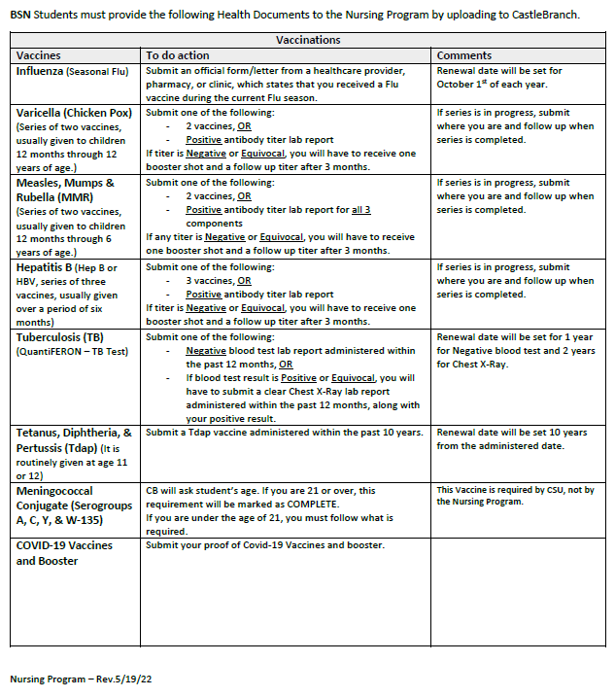
Guide for Clinical Documents
Notes:
Hope

Slide 17
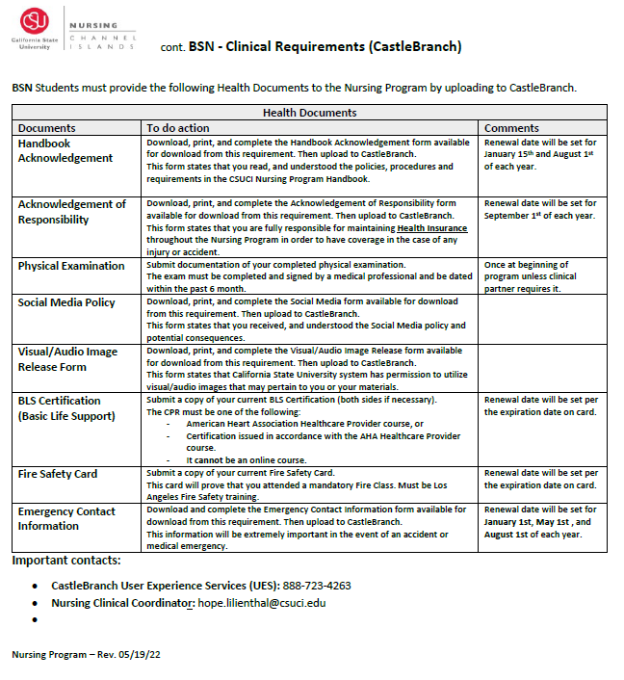
Notes:
Hope

Slide 18
Nursing Program Website Introduction
Nursing.csuci.edu
Incoming Students - Nursing Program - CSU Channel Islands (csuci.edu)
Notes:
Steph

Slide 19
Summer To Do List
Read
Read the BSN Student Handbook
Complete
Complete the BSN Orientation Canvas Course
Purchase
Purchase scrubs and name tags
Purchase
Purchase Exxat and upload all documents by due dates on the checklist
Attend
Attend transfer orientation
Purchase
Lippincott Bundle (option 1 or 2)
Attend
2nd orientation in July
Notes:
LaSonya

Slide 20
Checklist:
Nursing Program Checklist
BSN- Camarillo
http://nursing.csuci.edu/incoming-students
August 15th, 2024
Transfer Orientation (transfer students only)
Due July 10th, 2024
All documents noted below MUST be uploaded to EXXAT.
Please refer to EXXAT for details.
Background Check/ Drug Screening
Physical Examination - signed by Medical Provider
QuantiFERON TB blood test
Proof of Immunizations
BLS Certification
Covid Vaccine & Booster
Acknowledgment of Handbook
Acknowledgment of Responsibility (Health Insurance)
Acknowledgment of Social Media Policy
Acknowledgment of Visual/Audio Image Release
Emergency Contact Information
Due August 1, 2024
Order Scrubs, Name Tag, White Coat and Stethoscope
Purchase Lippincott Book Bundle
All documents listed are required by every student. Failure to meet these program requirements will prevent you from attending clinical rotations.
Notes:
Stephanie

Slide 21
Questions
Notes:
LaSonya

